Slide 1
Computer Network Labs
Lab 4
IP Subnetting
&
Variable Length Subnet Mask (VLSM)

Slide 2
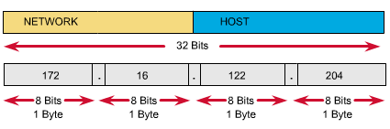
IP Addressing
IP address classes: A, B, C, …..

Slide 3
Subnetting
A subnet is a physical segment in a TCP/IP environment that uses IP addresses derived from a single network ID.
By partitioning the bits in the host ID into two parts, Subnet ID and the Host ID, a single Network Address can be used to uniquely define a set of subnets.
The number of hosts available for the Network address will be distributed among the subnets.

Slide 4
Subnet Mask and IP
A subnet mask is a 32-bit address used to block or “mask” a portion of the IP address to distinguish the network ID from the host ID.
Each host on a TCP/IP network requires a subnet mask, either a default subnet mask or a custom subnet mask.
A default subnet mask is used on TCP/IP networks that are not divided into subnets.
In the subnet mask, all bits that correspond to the network ID are set to 1. All bits that correspond to the host ID are set to 0.

Slide 5
Subnetting Example
Divide 196.200.150.0 into 15 sub-networks.
Needs to borrow 5-bits from the host part to have 15 sub -networks.
196
200
150
5-bits
3-bits
Subnet mask: 11111111.11111111.11111111.11111000
i.e., 255.255.255.248 or we can write it as
196.200.150.0 / 29

Slide 6
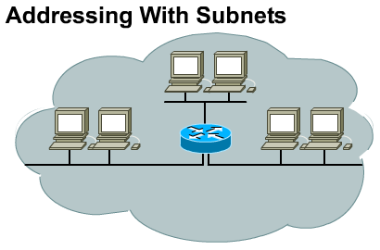

Slide 7
Variable Length Subnet Masking (VLSM)
VLAM is the process by which we take a major network address and use different subnet masks at different points.
If we have to keep the subnet mask the same we encounter severe problems concerning addressing space.

Slide 8
Variable Length Subnet Masking (VLSM)
Consider a class “C” IP address : 200.10.15.x
Default (subnet) mask (SM): 255.255.255.0
SM 255.255.255.192 /26 → 2 subnets @ 62 hosts
SM 255.255.255.224 /27 → 6 subnets @ 30 hosts
SM 255.255.255.240 /28 →14 subnets @ 14 hosts
SM 255.255.255.248 /29 →30 subnets @ 6 hosts SM 255.255.255.252 /30 →62 subnets @ 2 hosts
When do we need to use different subnet masks?

Slide 9
Variable Length Subnet Masking (VLSM)
E1
E2
R
R
Leased Line
Colombo
Head Office
50 hosts
Kandy
Branch Office
25 hosts

Slide 10
Variable Length Subnet Masking (VLSM)
E1
E2
R
R
Subnet 2
Colombo
Head Office
50 hosts
Kandy
Branch Office
25 hosts
Subnet 1
Subnet 3

Slide 11
Variable Length Subnet Masking (VLSM)
E1
E2
1
1
1
1
R
R
50
25
Colombo
Head Office
50 hosts
Kandy
Branch Office
25 hosts
No of IP Addresses Required
50+25+1+1+1+1 = 79

Slide 12
Variable Length Subnet Masking (VLSM)
For the serial link – needs only 2 IPs SM – 255.255.255.252
IPs – 200.10.15.5 /30 and 200.10.15.6 /30
For Kandy subnet – needs 26 IPs SM – 255.255.255.224
IPs – 200.10.15.33 /27 → E2 and
200.10.15.34 /27 to 200.10.15.58 /27 (m/c)
For Colombo subnet – needs 51 IPs
SM – 255.255.255.192
IPs – 200.10.15.65 /26 → E1 and
200.10.15.66 /26 to 200.10.15.115 /26 (m/c)

Slide 13
Variable Length Subnet Masking (VLSM)
E1
E2
200.10.15.5/30
200.10.15.6/30
R
R
200.10.15.33/27
200.10.15.65/26
Colombo
Head Office
50 hosts
Kandy
Branch Office
25 hosts
200.10.15.66 – 200.10.15.115/26
200.10.15.34 – 200.10.15.58 /27

Slide 14
Exercise 1
Consider the following Address
192.168.1.0/24
Default Subnet Mask is 255.255.255.0
Requirements
  1 Subnet of 120 hosts
  2 subnet of 59 hosts
Note: Always solve that requirement first which have greater number of Hosts in VLSM

Slide 15
Exercise 2
Consider the following Address
192.168.1.0/24
Default Subnet Mask is 255.255.255.0
Requirements
  1 Subnet of 30 hosts
  2 subnet of 60 hosts
  2 subnets of 12 hosts
Note: Always solve that requirement first, which have greater number of Hosts in VLSM

Slide 16
VLSM
PRACTICAL EXAMPLE

Slide 17
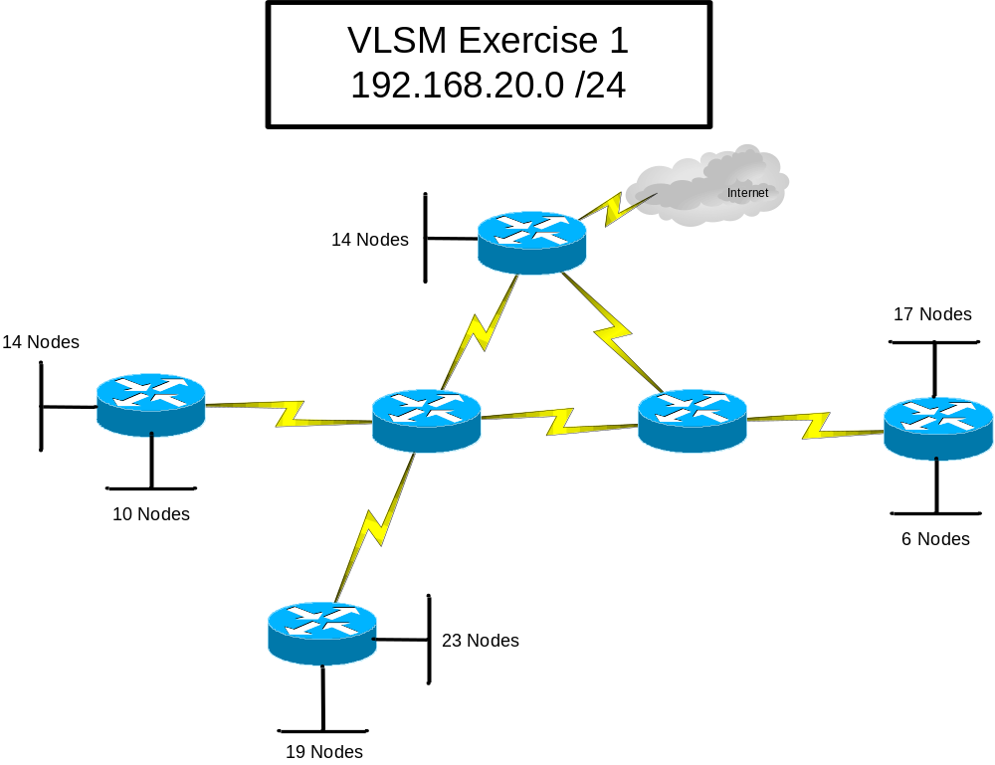
Practical Example

Slide 18
Do we have enough addresses?
How many addresses have been allocated?
How many are needed?

Slide 19
Practical Example

Slide 20
Address Allocation
Total Address Needed:
LANs = 14+10+19+23+6+17+14 = 103
WANs = 4+4+4+4+4+4 = 24
Total = 103 + 24 = 127

Slide 21
Scaling Subnets
With a requirement of 23 nodes…
The next perfect power of 2 that meets this need = 32
2⁵ = 32 5 host bits needed
Last Octet is then represented as:
  A.B.C.NNNHHHHH N=Network H=Host
  11111111.11111111.11111111.11100000

Slide 22
Subnetting Examples
SubnetMask SubnetMask # Hosts
255.255.255.0 /24 256 (254)
255.255.255.128 /25 128 (126)
255.255.255.192 /26 64 (62)
255.255.255.224 /27 32 (30)
255.255.255.240 /28 16 (14)
255.255.255.248 /29 8 (6)
255.255.255.252 /30 4 (2)

Slide 23
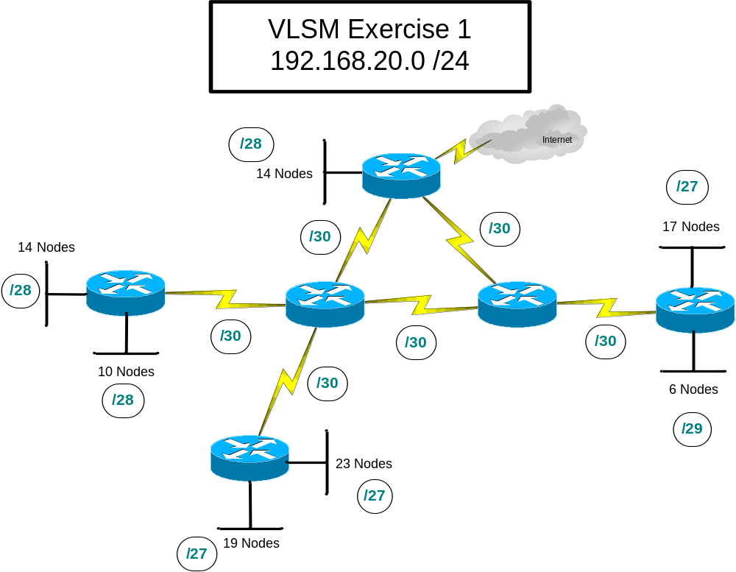
Practical Example

Slide 24
Address Allocation
Total Addresses Needed:
LANs = 16+16+32+32+8+32+16 = 152
= /28 + /28 + /27 + /27 + /29 + /27 + /28 = 152
WANs = 4+4+4+4+4+4 = 24
= /30 + /30 + /30 + /30 + /30 + /30 = 24
Total = 103 + 52 = 157

Slide 25

Reference Points
Use numbers, symbols, letters to represent each LAN / WAN link
Use some consistent method for assignment
  Size of Subnetwork
  Location

Slide 26
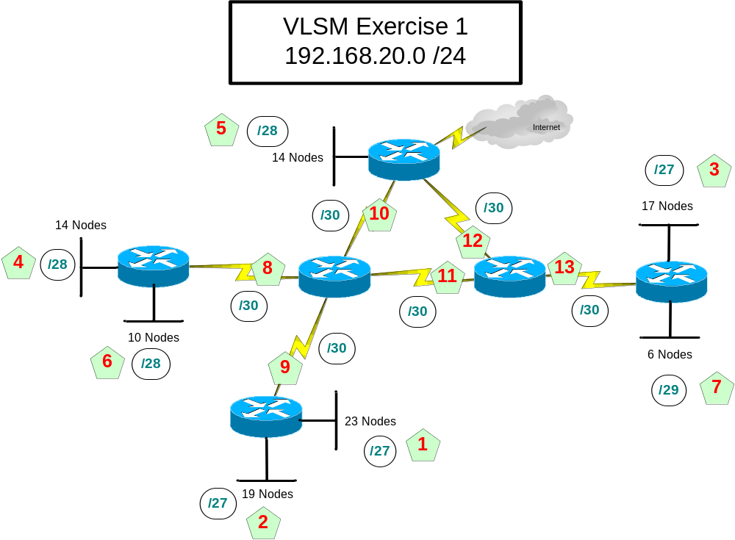
Assign Reference Points

Slide 27
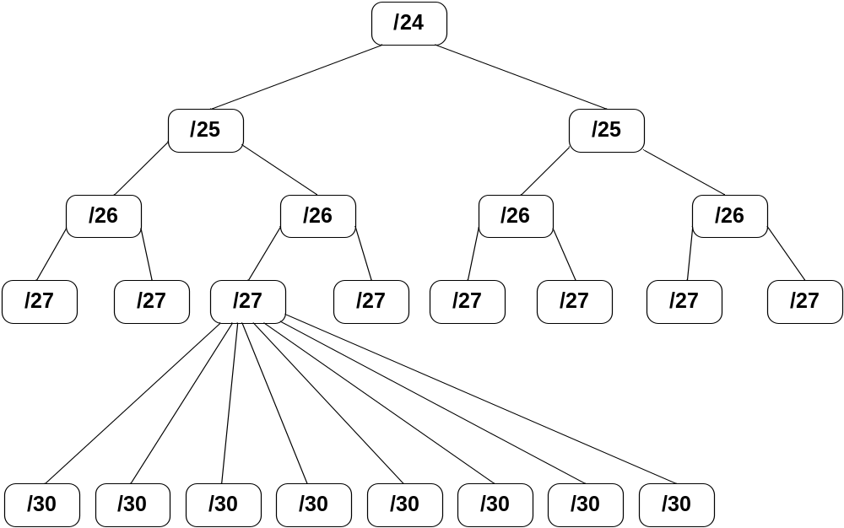
Subnetting

Slide 28
VLSM and Routing Protocols
Does your routing protocol support varying the length of the subnet mask from one interface to another?
Can you re-subnet a subnet differently from one interface to another and still advertise that subnetwork via RIPv1, RIPv2, OSPF, EIGRP, ISIS, BGP?

Slide 29
Routing Protocols
Supporting VLSM
  RIP version 2
  EIGRP
  OSPF
  ISIS
Not Supporting VLSM
  IGRP
  RIP version 1

